Slide 1

Understanding, Measuring, & Assessing the
Development of Interpersonal Skills in 4K
Kristin Shutts & Charles Kalish
Presentation for the MEP Symposium
April 26, 2018

Slide 2
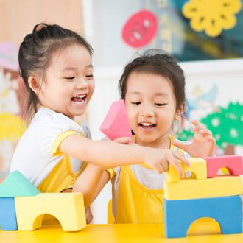
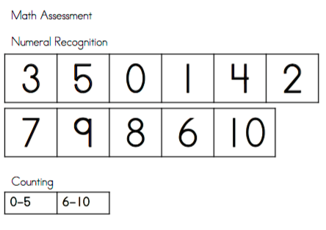

Social Skills
Notes:
Many researchers think social skills (making friends, getting along with others, etc) are important for children’s school (and later) success. But … less agreement about how to measure them. We have fairly well developed, objective measures for assessing more traditional “academic skills” [CLICK} test of pre-reading and pre-numerical skills, for example. So, we can say to a parent how many letters her child recognizes for, example. But there’s not the equilavant for social skills.

Slide 3

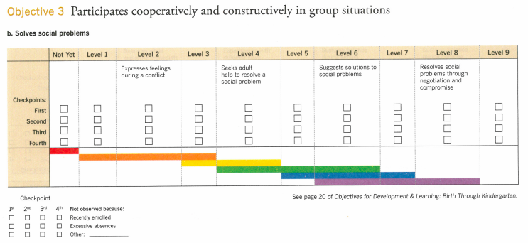
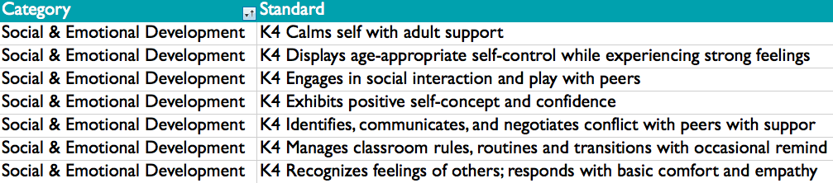
Social Skills
Notes:
What we have instead are ratings (MMSD 4K school sites use GOLD; community sites can use GOLD or their own tools) and grades from teachers reporting on children’s social skills.
Why is this a problem? Well, first of all, it might not be. Teachers know their students well and observe them across mulitiple contexts. The grades and ratings they give might be the right way to measures social skills.
However, we reasoned that one could imagine problems with this approach. (1) For example, some aspects of social development might be easier to see than others. Thus, some skills – including areas of strength and to-be-developed strengths – may go unmeasured. (2) Further, assessing social skills – knowing what signs to look for, what to try to elicit, what’s typical, etc -- could be hard for less experienced teachers. (3) Finally, one could imagine implicit or cultural biases in evaluation, which could lead to over/under-identificaiton of skills in individual children.

Slide 4
Our Project: Phase I
In Spring of 2017, we met with 30 teachers and administrators across 17 different 4K sites to learn …
Are social skills important to develop in 4K?
What social skills are important to develop in 4K?
Thoughts about current measures
Notes:
FIRST: Thus, the focus of our MEP project was on understanding how social skills are currently thought about and measured in 4K, and to see if we could contribute useful measures
Our project had multiple phases [CLICK] In phase 1….

Slide 5
Our Project: Phase I
Are social skills important to develop in 4K?
Every person we talked to said yes
Most said the domain was more important than any other
Notes:
This is in line with stated goals of MMSD – but it was meaningful to hear that because in our interviews we made it clear that we weren’t representing the district and we wanted teachers’ and administrators’ honest thoughts in response to our questions.

Slide 6
Our Project: Phase I
What social skills are important to develop in 4K?
Intrapersonal skills:
Impulse control
Flexibility (task-switching)
Managing one’s feelings
Interpersonal skills:
Take another’s perspective
Make friends
Make sense of & get along in social interactions
Be in tune with the group
Notes:
We have all heard of executive function, mindsets, and self control – and teachers certainly listed such skills when we asked which skills were important to develop.
Those are important, but there is a lot more to social skills than that
[CLICK]
And teachers appreciated that and went on to list a variety of what we’d call “interpersonal skills” – so skills that take place between people rather than within a person. And these are the domains where there’s especially a paucity of direct measures in the field.

Slide 7
Our Project: Phase I
What do you think of current measures available to you for assessing children’s social skills?
Many teachers thought they had a good sense of their students’ social skills.
Some teachers felt that the proportion of the time they spent formally assessing & documenting children’s various skills wasn’t in line with the stated and felt importance of social skills.
A lot of discussion of GOLD …
Notes:
As I said earlier, it’s not true that MMSD 4K isn’t assessing children’s social skill development – students receive report cards (that include SEL items), and teachers produce GOLD ratings for each child (at least in school sites), including ones focused on SEL. We were interested in what educators thought of these measures, with an eye toward what we might be able to add.
(2) Some discussion about the fact that even though SEL skills are the most important skills to be developing in 4K, that isn’t reflected on the report card – other non-social skills make up the bulk of report cards.

Slide 8
Our Project: Phase I
About GOLD …
Very common responses:
It takes too much time
I don’t have time to do it
Additionally, some said:
No one ever looks at it
Not great professional development around it
Useful for lesson ideas, but not evaluation
Not clear: evaluating child or evaluating self?
Notes:
LAST: So, we didn’t hear frequently that the GOLD was missing an opportunity to assess a particular skill, but rather that it was quite onerous. And that’s useful to hear when we think about developing other kinds of measures – we don’t want our measures to be more onerous than something like the GOLD, and we certainly would want any measures we contributed to be going beyond what teachers are able to assess on their own – otherwise, new measures aren’t worth it.

Slide 9
Our Project: Phase IIa
Notes:
With teachers’ comments in mind, as well as our own understanding from the literature of what constitutes core social skills for children, we came up with a set of skills measures that I’d like to give you the flavor of.. – Just note that in each case I’m just going to show you one example, but for the actual measure children would complete multiple trials with multiple displays that varied in various ways – for example, sometimes the “right” answer will be on the left, sometimes on the right, etc. And I’ll note that the person administering the measures was someone from our research team, who sat down individually with each child who participated.

Slide 10
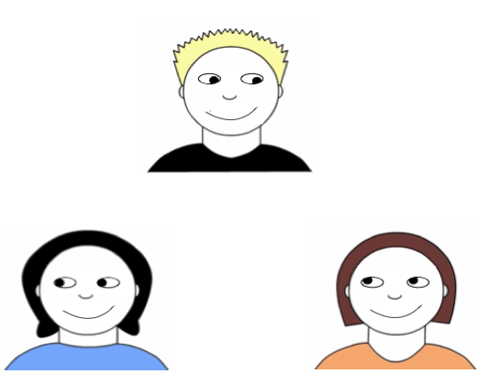
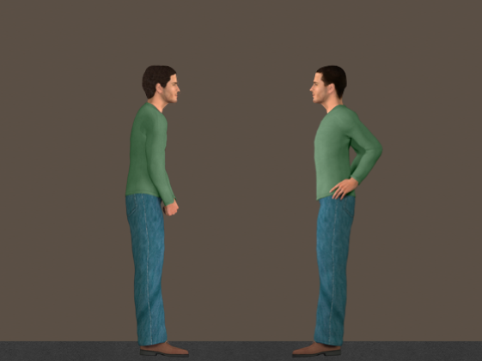
Relationships: detecting affiliation and status
Who is friends with
[top person]?
Which person is in charge?
Notes:
Some of the measures focused on children’s sensitivity to cues to different kinds of relationships – certainly, if you are going to be able to participate effectively in a group and negotiate social relationships, you need to have some way of assessing whose friends with who and who is has more or less social power – large growing research literature on the dev of these capacities, though not with a school context in mind.

Slide 11
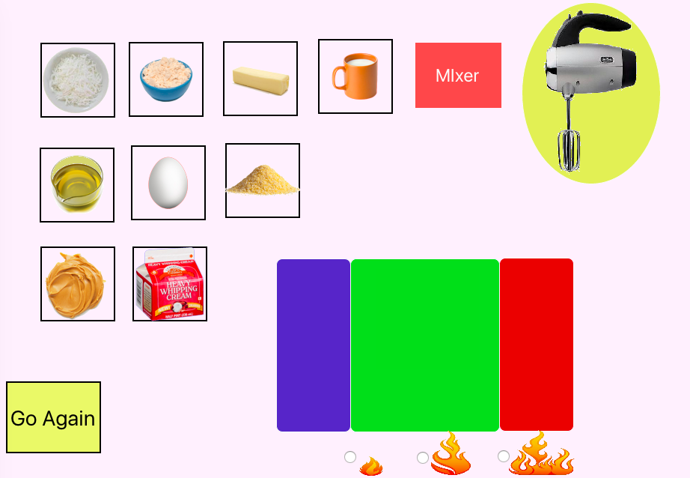
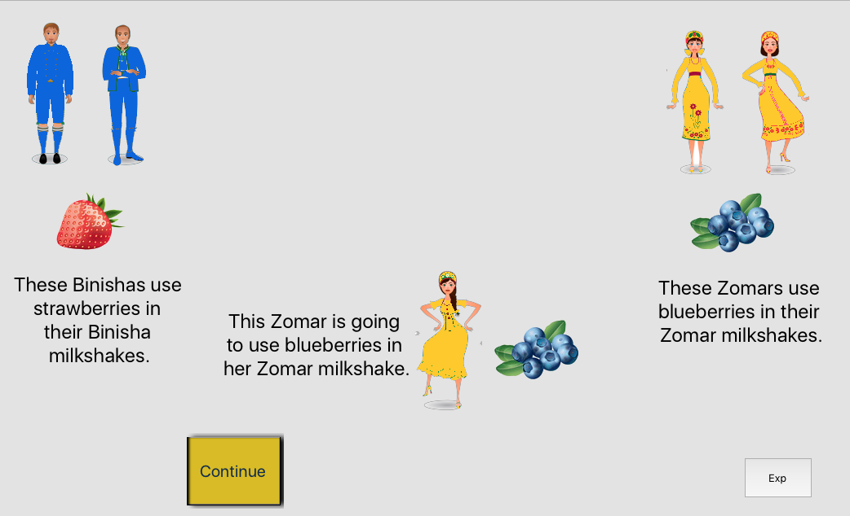

Social learning: following & seeking information
Notes:
Some of the measures focused on children’s developing skills of being a good social learner – so this includes being interested in how people are doing a task and being able to copy that way. And, knowing whom to ask if you don’t know something – peers good for some things; adults for others.

Slide 12
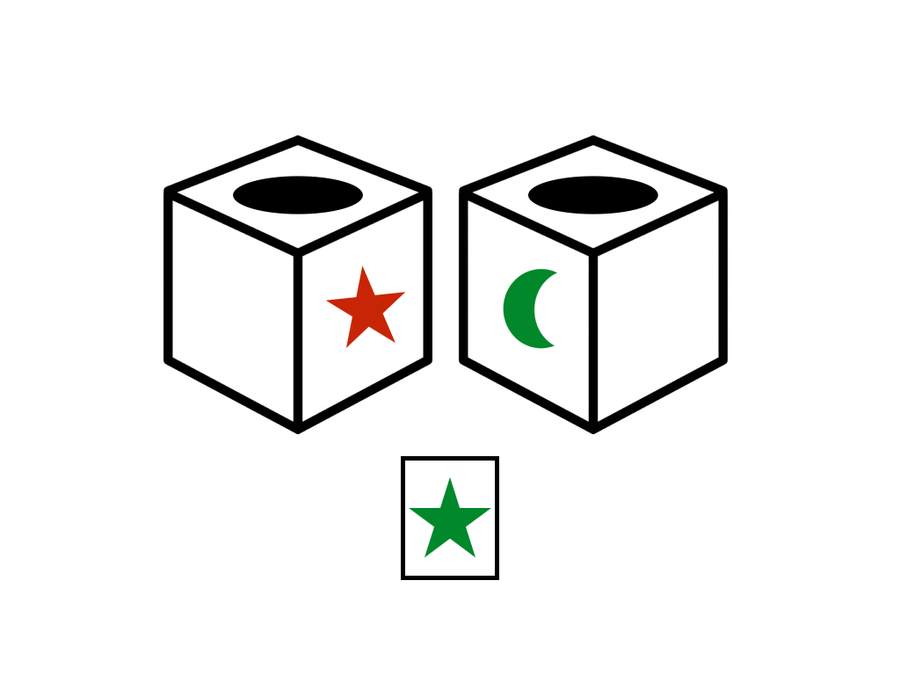
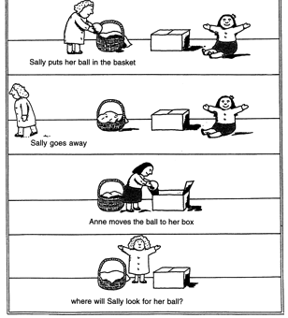

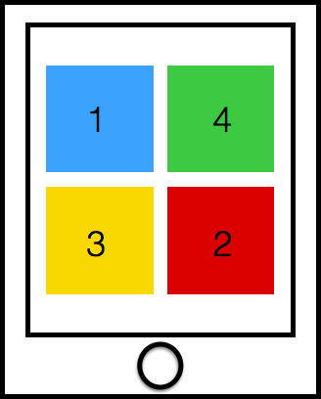
Other Measures
Additional Interpersonal
Intrapersonal Skills
Perspective Taking
Reading Emotions
How is this kid feeling?
Notes:
(2) So measures of executive functioning

Slide 13
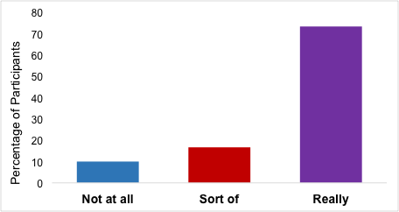
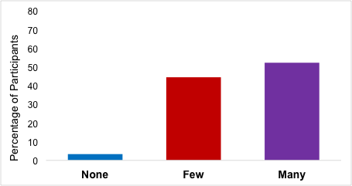
Other Measures
Do you like school?
Do you have friends?
Notes:
We also just asked kids if they liked school and if they friends
And those data are easy to show – as you’ll see the vast majority of children said they really liked school and that they had friends

Slide 14
Phase IIb
We administered our measures to 95 children enrolled in 4K at four different sites.
We also asked teachers to rate each child on each of the skills we measured.
Thus, we have 3 kinds of teacher assessments (ones we collected, 4K report card grades, GOLD ratings).
Notes:
Sample was diverse – half girls, half boys; less than half of children were white; about half on free/reduced lunch
LAST: Just going to highlight a couple of our analyses for you.

Slide 15
How well our tasks correlate with ratings we collected from teachers
Teacher Rating
r = .51
Student Task Performance
Notes:
This is the teacher’s average rating of the student (Y axis) as a function of the student’s average performance on our tasks
Correlated at R= .51
Teachers’ ratings of how their students would do on our tasks were correlated with how well students did on our tasks. Thus, teachers know their students (not surprisingly!). Related, suggests are measures aren’t off-base.

Slide 16
How well our tasks correlate with report card SEL items
Report Card SEL
r = .47
Student Task Performance
Notes:
Here you see a very similar relationship, looking at how well our tasks correlate with SEL report card items. Again, you see a relationship, though just as in the previous graph it’s not perfect – and I’ll come back to that in a minute.

Slide 17
Which of our tasks were best/worst at predicting SEL grades?
Best:
Worst:
Notes:
Best is liking school, figuring out hierachies and copying
Worst is a norms task (“Knowing when you have choice to do whatever you want, vs when there is a right way you are supposed to do something” – Seeing that those are DIFFERENT), school friends, and determining expertise

Slide 18
Take-Home & Future Directions
Teachers see social skill development as a primary goal of 4K
Our tasks overlap, though not perfectly, with teachers’ assessments of students.
Next year: Which measures (alone or together) best predict children’s success in kindergarten?
Notes:
And we found – based on our interviews and observations – that they reported many strategies for teaching skills, including ones suggested by CC, as well as looking for opportunities in natural play
Suggests they aren’t off-base, but also suggests we might be picking up on variance that isn’t perhaps captured by ratings. (more analyses to come, though!)
Real test of the utility of our measures and whether they add anything – and if some measures are more useful than others

Slide 19
Acknowledgements
4K teachers and principals who participated in interviews
Allis, Franklin, Sandburg, & Thoreau
MEP for support
My collaborators: Chuck Kalish and Rachel King

Slide 20
How well the ratings we collected from teachers predict report card grades
Report Card
r = .68
Teacher Ratings
Notes:
R= .68
So teachers predicted own scores well

Slide 21
How well our tasks correlate with report card grades (all areas)
Report Card
r = .56
Student Task Performance
Notes:
R = .56

Slide 22
How well do our tasks correlate with the GOLD-SEL
r = .29

