Slide 1

Enhancing Equity Through 4K
Presentation for MEP Research Symposium
Eric Grodsky
April 26, 2018

Slide 2
MEP Directed Reports in 2017-18
Enrollment report: Who enrolls in MMSD 4K? Is 4K reaching all student populations in the district?
Readiness report: How if at all is 4K enrollment related to 5K fall literacy and 5K behavioral skills?
Attendance report: How does attendance vary among MMSD students in grades K-3? How is attendance associate with learning outcomes?

Slide 3
Enrollment highlights
Students from low-income families
Latino & African American students
All students
Notes:
Enrollment grew from 68% of K in 2012-13 to 74% of K
Enrollment higher for less advantaged families:
81% for children from less advantaged families
About 80% for African American and Latino students

Slide 4
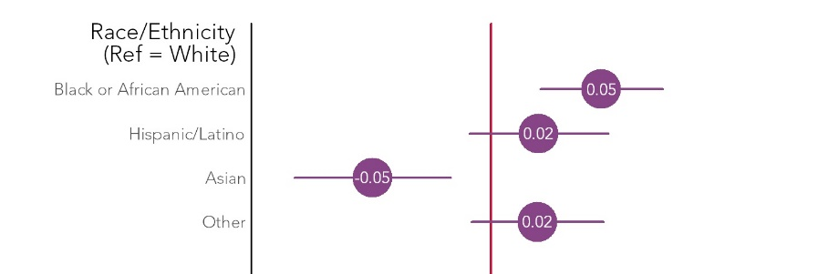
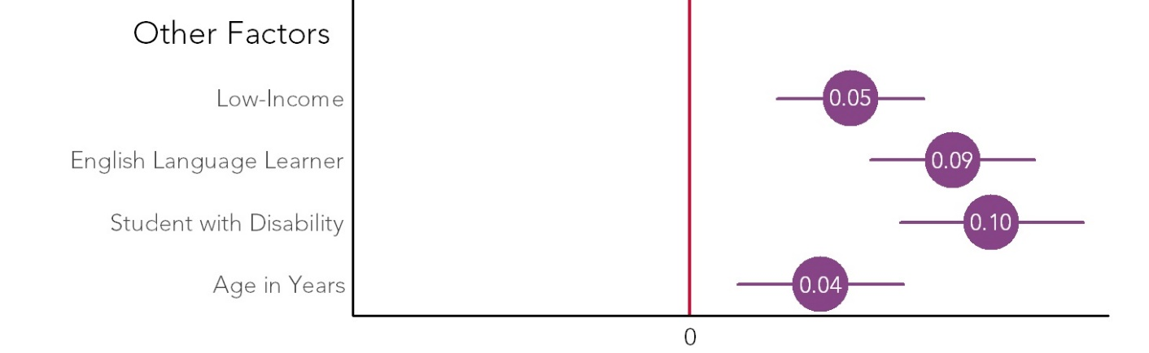
Enrollment highlights
Notes:
Statistically adjusting for other characteristics of children and their families shows 4K is reaching students and families that face greater challenges in Madison.
These graphs shoe]w the different in percentage points in the probability of enrolling in 4K for different children. The red line is at 0– so no difference in probability.
Statistically adjusting for other characteristics of children and their families:
African American
Latino
students from families with low incomes
ELL
students with disabilities

Slide 5
Enrollment highlights
Compared to similar districts in the state*
  Enrollment advantage of African American and Latino students is about the same
  Enrollment advantage of students from low-income families is about the same
  Enrollment advantage of English language learners is higher (4 percentage point advantage compared to 5 percentage point disadvantage)
* Comparison districts include Beloit, Brown Deer, Green Bay Area Public, Kenosha, Milwaukee, Racine Unified, Wauwatosa and West Allis-West Milwaukee

Slide 6
Enrollment highlights
“Overall, this report suggests an equitable, if not progressive, distribution of 4K services in the district.”

Slide 7
Kindergarten readiness highlights
The average association between 4K enrollment and fall 5K PALS scores is positive but modest
  The typical 5K student outscores about half of her peers on the 5K literacy screener (PALS)
  The typical 4K enrollee outscores 52% to 53% of her peers on the 5K screener, all else equal*
An advantage to 4K enrollment of 2% to 3%
*”All else” is family income, parent education, race/ethnicity, sex, ELL, IEP

Slide 8
Kindergarten readiness highlights
Notes:
Variation in association between 4K enrollment and K literacy skills.
[TALK THROUGH HOW TO READ THIS]

Slide 9
Kindergarten readiness highlights

Slide 10
Kindergarten readiness highlights

Slide 11
Kindergarten readiness highlights
Probability of consistent prosocial behavior (report card)
Probability of consistent classroom effort (report card)
Notes:
In addition, we analyzed kindergarten reports card to see how if at all 4K is related to student behavior.
Consider two sets of indicators from old report cards. One set measures prosocial behavior, including listening skills, self-control and respect for others
Another set measures classroom effort and includes teacher assessments of student participation, persistence on tasks and independence.
We found that 4K participant were 3 ppt more likely to engage in consistently prosocial behavior, including engaging in self-control, cooperating, respecting others and solving conflicts appropriately.
Children from school sites appeared slightly more likely than those in ECE sites to consistently engage in prosocial behavior, but the difference is small could be due to chance.
We did not find any association between 4K enrollment and classroom effort (completing assignments, persisting in tasks, organizing work).

Slide 12
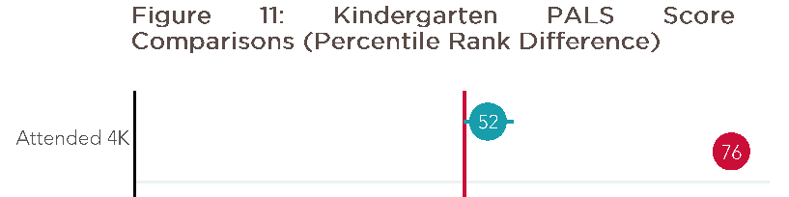
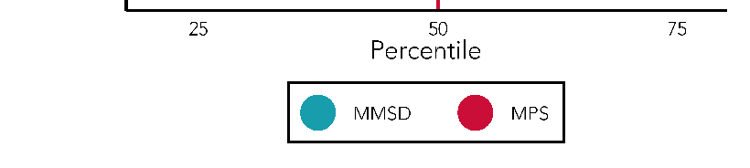
Kindergarten readiness highlights: District comparison
Notes:
Not just full day!

Slide 13
Conclusions
Enrollment in MMSD’s 4K program is associated with
  Substantial reductions in inequality in literacy skills at the start of kindergarten.
  Modest increases in the probability of consistently engaging in prosocial behaviors early in 5K
MMSD’s 4K Could be even more equity enhancing
  What does MPS do beyond offering a full day program?

